Slide 1
MUSCLEHUB together STRONG
Analysis of Sales Fall Sales Campaign
Analyst: Shawn Chen
Jan 2018

Slide 2
Overview
Big THANKS to marketing and sales teams on a fine quarter!
Launched FitTest for applicants
Separate track for Jumpstarts (no FitTest)
Review of applications & membership results
Analysis and findings

Slide 3
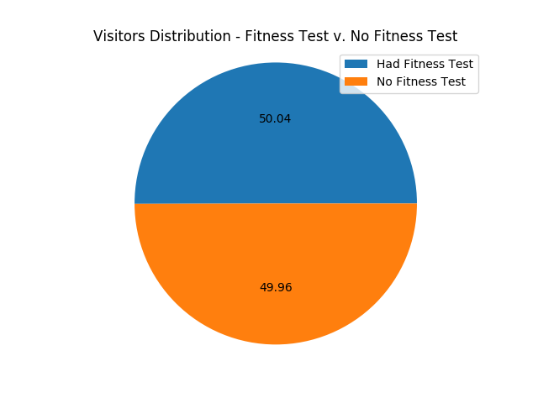
SIGNup TRACKS
5004 Visitors during Fall –
~50/50 distribution of visitors

Slide 4
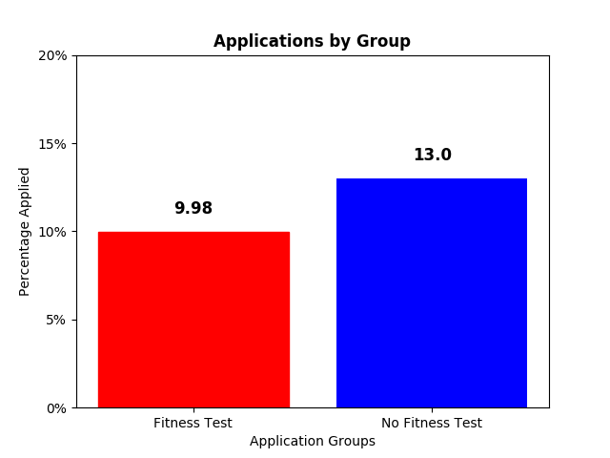
ApplicaNT RATE
~9.98 Fitness Test
v.
13% No Fitness Test
~3% (325 v 250 applications) higher applications in no fitness test group
There is a higher chance a visitor will apply if no test is given*
*Result confidence validated with Pearson’s Chi Square Test pval < 1/10th of percent (0.00096..)

Slide 5
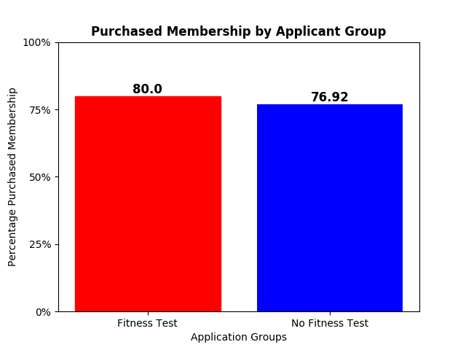
Membership FROM APPLICATIONS
80% (200 of 250) Fitness tested applicants
purchased membership
v.
~77% (250 of 325) Non-Fitness tested
The difference does not
appear significant*
*Pearson’s Chi Square Test pval is ~43.26%

Slide 6
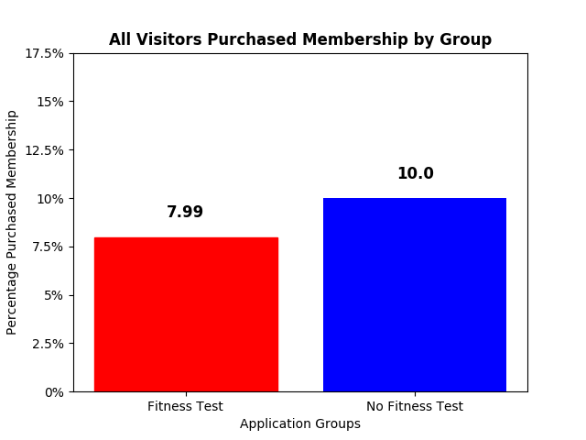
Membership Purchase by GROUP
10% of Visitors without Fitness test
purchased membership (250)
v.
~8% Fitness tested (200)
25% more membership sign-up from visitors that did not receive a fitness test* (1 in 4)
*Analysis of data suggests a good level of confidence. Pearson’s Chi Square Test pval is ~1.5% (< 0.05)

Slide 7
SUMMARY & RECOMMENDATIONS
Visitors were more likely to apply and purchase a membership when not offered a fitness test
13% v. 10% applications of 5000 visitors
10% v. 8% membership purchase
Recommend no fitness test offering for sign-ups moving forward and green light “we will get you there together” campaign

